Slide 1
Cotiviti
Ansible Review
6am slides by Alan Leberknight - Red Hat Solution Architect

Slide 2
Agenda
Background
Goals
Ansible Review (Ansible, Tower, Inventories, Plays)
Storage & Ansible (what’s out there)
Next Steps
Summary
‹#›

Slide 3

Background
Storage team - configure storage for VM workloads running in a vmWare environment
Configure storage on storage devices such as netapp, pure storage, S3
Notes:
The team would like a way to more easily manage their environment from end to end, i.e.
Provision
Maintain
Monitor

Slide 4
What we’ll cover today
Ansible review
Key parts of ansible
We’ll spend time writing plays
What’s a role
Ansible galaxy
Automation Hub
Ansible Tower
Why use it?
Review some features - I’ll walk through Tower in my lab
Things to think about

Slide 5
Automation happens when one person meets a problem they never want to solve again

Slide 6
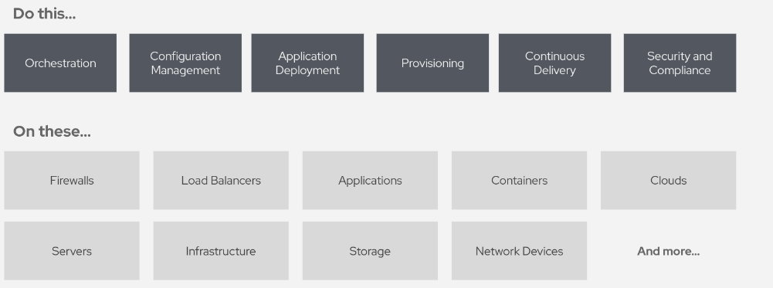
What can you do with Ansible?

Slide 7
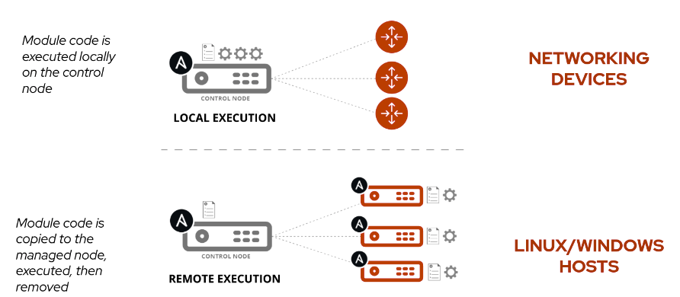
How Ansible automation works

Slide 8
Inventory
Ansible works against multiple systems in an inventory
Inventory is usually file based - we’ll discuss dynamic inventory
Can have multiple groups
Can have variables for each group or even host

Slide 9
Static Inventory Example
# static inventory example:
[myservers]
10.42.0.2
10.42.0.6
10.42.0.7
10.42.0.8
10.42.0.100
host.example.com

Slide 10
Understanding inventory - basic
May not be a real hostname
[app1srv]
appserver01 ansible_host=10.42.0.2
appserver02 ansible_host=10.42.0.3
[web]
node-[1:30] ansible_host=10.42.0.[31:60]
[web:vars]
apache_listen_port=8080
apache_root_path=/var/www/mywebdocs/
[all:vars]
ansible_user=alan
ansible_ssh_private_key_file=/home/aleberkn/.ssh/id_rsa

Slide 11
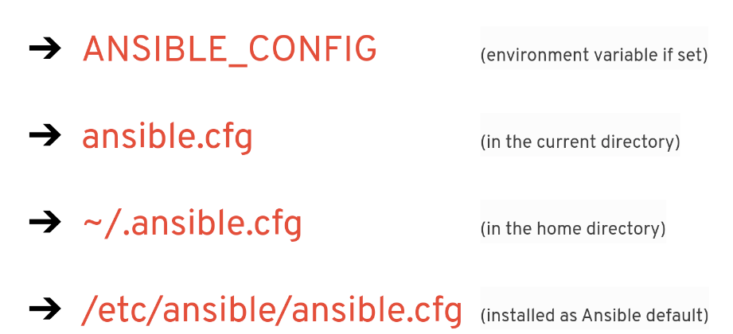
Ansible Configuration
Configuration files will be searched in the following order

Slide 12
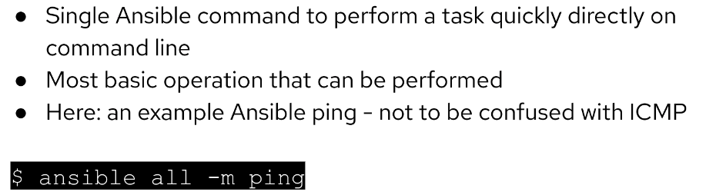
First ad-hoc command

Slide 13
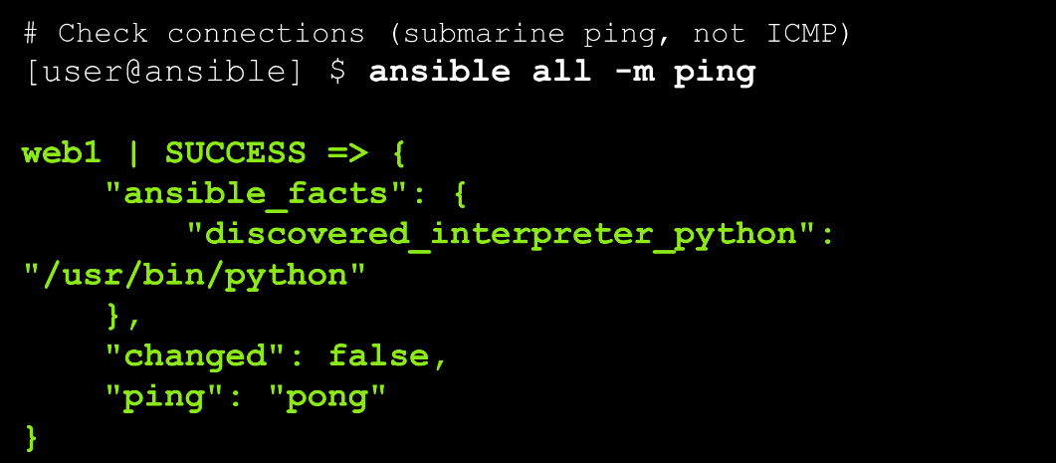
ad-hoc command: ping

Slide 14
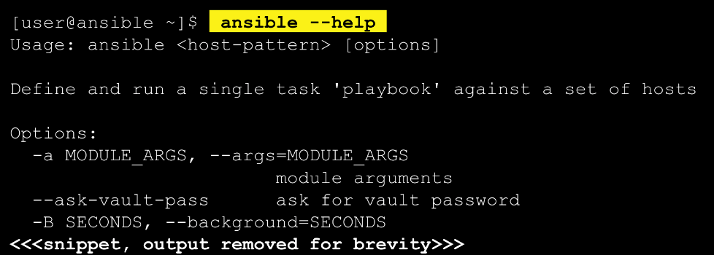
The Ansible Command
Some basics to help you from getting stuck (--help)

Slide 15
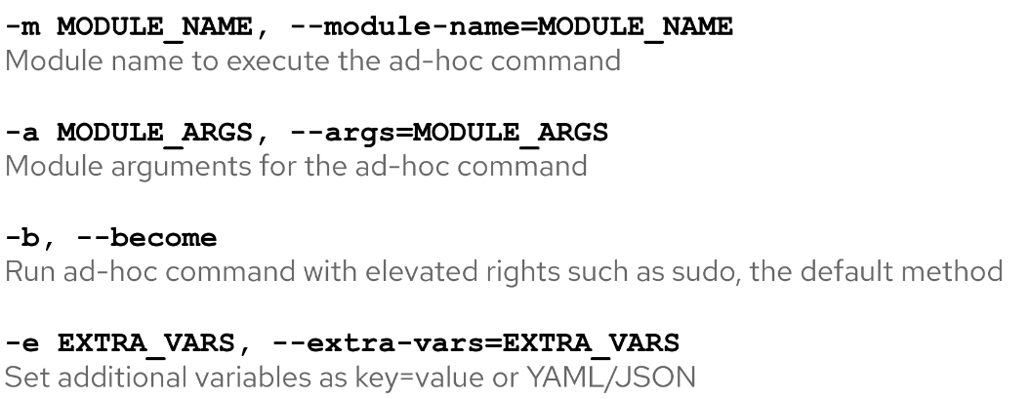
Ad-Hoc Commands
Here are some common options:

Slide 16
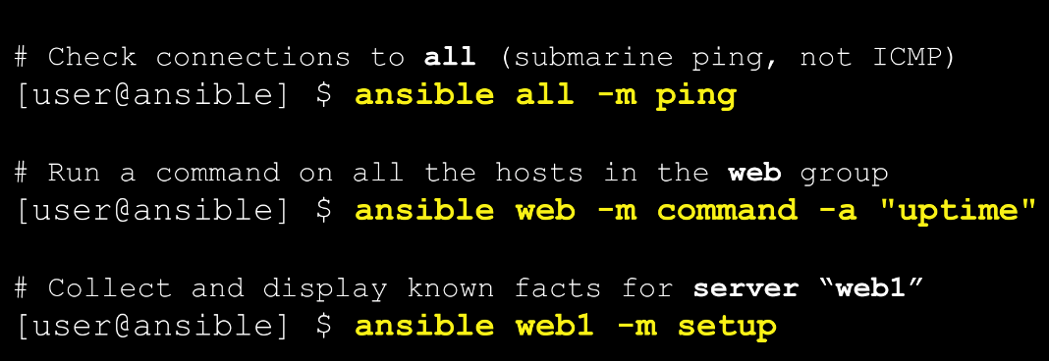
Ad-Hoc Commands
Here are some common options:

Slide 17
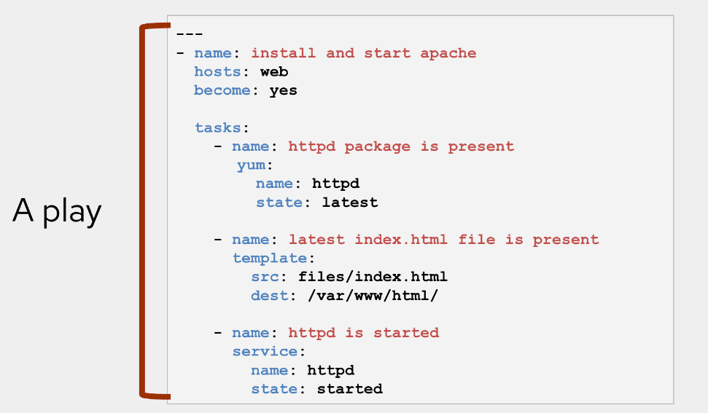
An Ansible Playbook

Slide 18
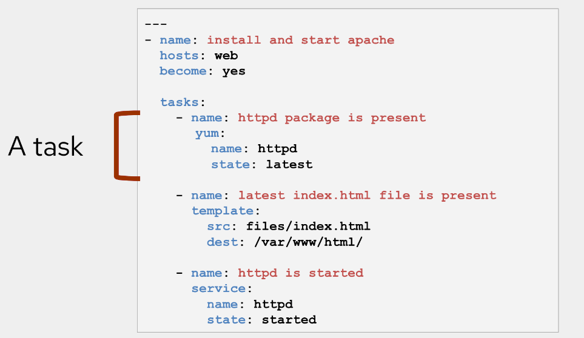
An Ansible Playbook

Slide 19
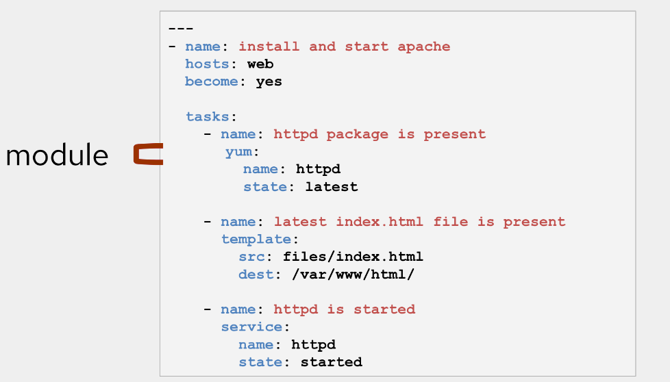
An Ansible Playbook

Slide 20
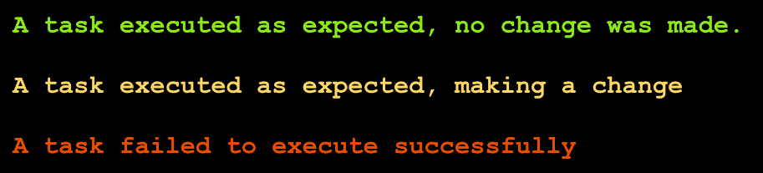
Running an ansible playbook
The most important colors

Slide 21
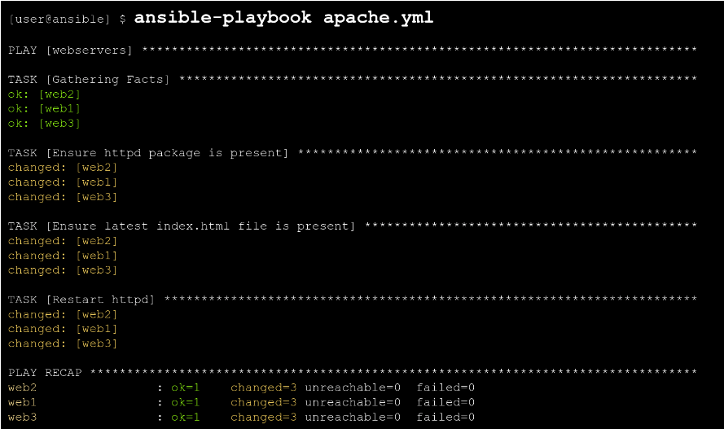
Running an ansible playbook
The most important colors

Slide 22
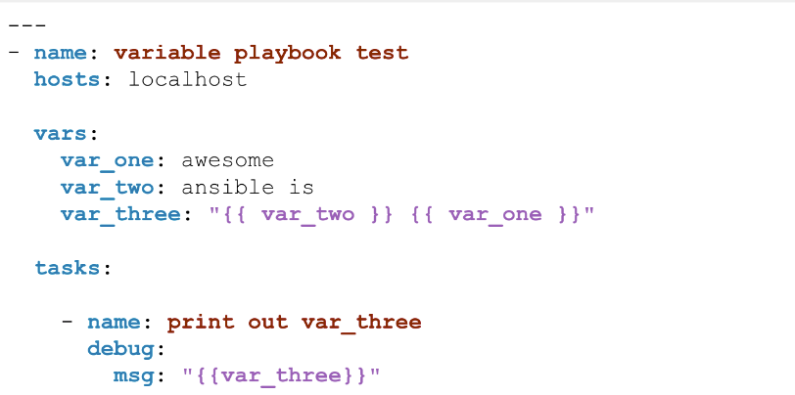
Variables
The most important colors

Slide 23
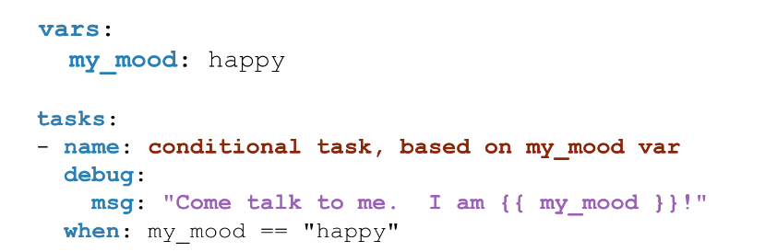
Conditionals via VARS
The most important colors

Slide 24
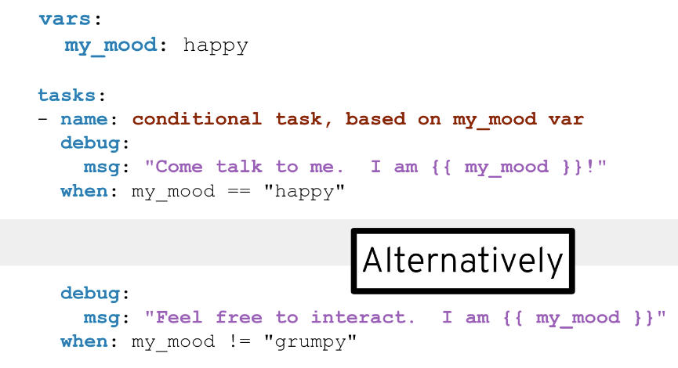
Conditionals with VARS
The most important colors

Slide 25
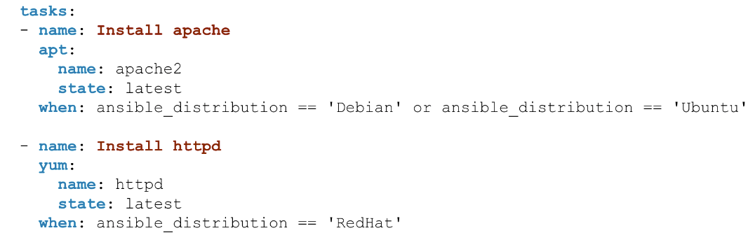
Conditionals with FACTS
The most important colors

